Slide 1
Trauma stigma and care
Monica Bellucci, M.Ed, LMHC
Clinical Coordinator, CIT/TTAC of Western MA

Slide 2
Learning objectives
Participants will be able to identify to identify stigma and how it affects those living with mental illness
Participants will be able to identify how the brain operates under prolonged stress
Participants will be able to identify trauma response and what they look like
Participants will be able to identify practical approaches to utilize when experiencing someone in a mental health crisis.

Slide 3
Activity
What are some ways we speak to those with mental illness? Green post-its
What are some ways speak about those struggling with cancer pink post-its

Slide 4
What is Stigma
Public Perception: Stigmatizing attitudes often lead to misconceptions about mental health conditions, viewing them as personal weaknesses or character flaws rather than legitimate medical conditions.
Labeling: People with mental health conditions may be unfairly labeled or defined solely by their condition, reducing their identity and potential to the challenges they face.
Social Isolation: Stigma can result in social isolation, as individuals with mental health conditions may be avoided or excluded due to fear or misunderstanding.
Discrimination: Stigmatization can lead to discriminatory behavior in various aspects of life, including employment, education, housing, and relationships.
Self-Stigma: People who experience mental health conditions may internalize the negative stereotypes and beliefs, leading to reduced self-esteem and reluctance to seek help.
Barriers to Treatment: Stigma can discourage individuals from seeking professional help or treatment, leading to delayed or inadequate care, which can worsen their condition.

Slide 5
Some Facts and Experiences of those with Mental Illness
Around 60% of adults with a mental health illness don’t receive care – NAMI
It takes on average 11 years from the start of a mental health symptoms to when someone receives treatment
Approximately 68% of women and 57% of men with mental health problems are parents. The most common mental health problems experienced during pregnancy and after birth are anxiety, depression and post-traumatic stress disorder (PTSD). (Mental Health Foundation)
Nearly 50% of all mental illnesses begin in childhood before the age of 14 years, (national institute of health)
More than one in five U.S. adults live with a mental illness (57.8 million in 2021). (NAMI)

Slide 6
Stigma
Myth: People with mental health conditions are more violent.
Only 3%–5% of violent acts can be attributed to individuals living with a serious mental illness. In fact, people with severe mental illnesses are over 10 times more likely to be victims of a violent crime than the general population

Slide 7
Stigma
People living with mental illness are more likely to encounter the criminal justice system, resulting in a large number of arrests and incarcerations. The overall annual cost of incarcerating people with serious mental illness in state prisons in Massachusetts reaches exceeds $250 million.

Slide 8
Trauma informed policing
What is wrong with you
To
What happened to you

Slide 9
Lets Talk About Trauma
What is trauma
  The lasting emotional response that results from living through a distressing event
  The effect on your brain’s emotional networks to make you over or under react to situations
  Anything which has overloaded out neuro and physical system which we haven’t been able to fully process and or metabolize.

Slide 10
Types of Trauma
Single event/Acute trauma
  Car accident
  House fires
  Mugging
  Sexual assault
Chronic Trauma/on-going
  War combat
  Domestic Violence
  Sexual Abuse
  Bullying
Complex Trauma/multiple on-going generally in the context of interpersonal relationships

Slide 11
Some Key Factors to Remember
What is traumatic isn’t always dramatic
Trauma is stored in the emotional center of our brain and in our bodies.
Trauma is not stored in our language and rational/cognition part of our brain
Trauma is not stored in a linear fashion

Slide 12
Reptilian Brain
Brain stem and cerebellum. It operates on instinct and is responsible for the survival-related functions of the of the body.
The reptilian brain is most closely associated with body processing. Instinctive trauma responses, such as fight, flight, freeze, or startle responses, and crying for help are all examples of reptilian brain functions. The reptilian brain also controls the autonomic responses that we experience as body sensations and basic life-sustaining processes, like digestion, heart rate, body temperature, and respiration.

Slide 13
The mammalian brain “emotional brain”
The mammalian brain includes the thalamus, amygdala, and hippocampus.
This is the emotional or limbic brain, is responsible for our emotional and relational experiences.
Emotions lend another dimension to our experience by letting us know of our likes and dislikes
relationships, it’s responsible for us feeling drawn towards or away from things and for holding emotional memories of our experiences.
These experiences of shared pleasure or pain are also encoded as nonverbal memories of attachment experiences, laying down templates for expectations of future relationships.

Slide 14
The Neocortex “Human Brain”
The cerebral cortex, the frontal cortex, is the front structure of our brain.
It contains most of our language/communication abilities. This hemisphere of the brain processes information in an explicit, direct, logical, analytical, and linear fashion.
It’s important for our functioning in a health lifestyle, that everything is integrated and linked.
This is the part of the brain that is “offline” when someone is experiencing a trauma response.
This part of the brain is not fully developed until around age 25. This is the youngest part of our brain both on an individual basis and an evolution basis

Slide 15
Trauma Responses
Involuntary responses, reactions or behaviors, that one may engage in during times of high and or chronic/toxic stress. These involuntary responses can be from “real” or perceived threats.
Fight –aggression
Flight – running, avoiding
Freeze – numbing, shutting down
Appease –overly compliant
What are some experiences law enforcement may have experienced in each of these responses

Slide 16


Slide 17
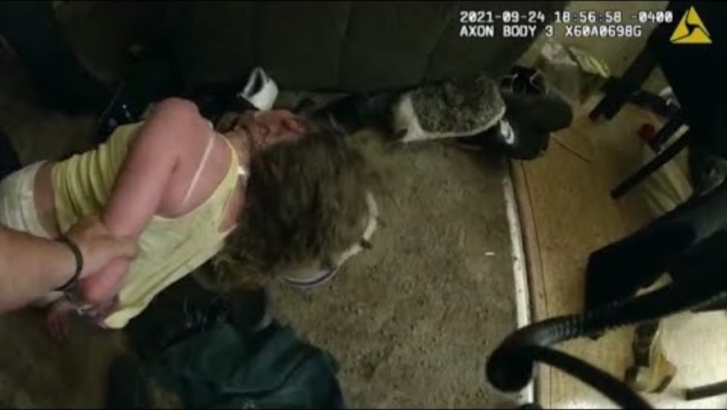
https://youtu.be/19Rkl6bWtos?si=oPAFl_LQFuJjRdTe

Slide 18
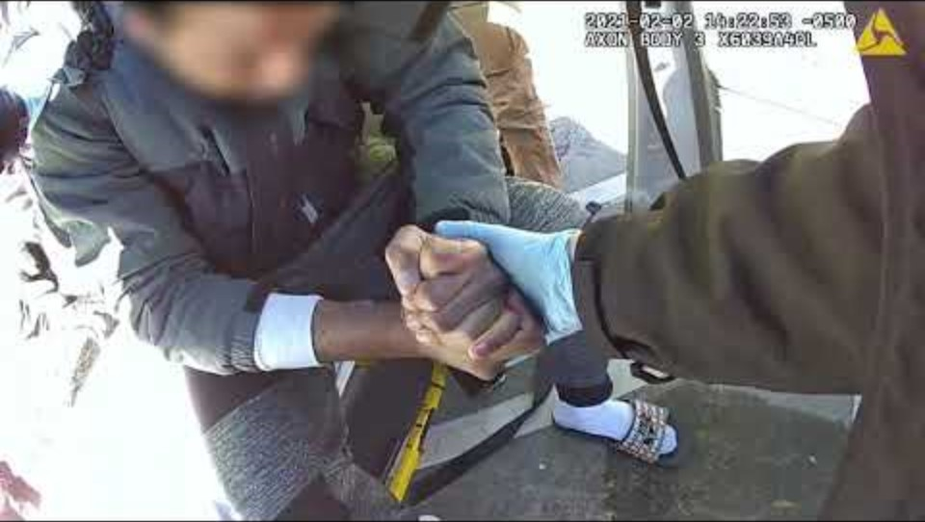
https://youtu.be/t2RJSn6zlLk?si=qTRixwu_HU3azIC7

Slide 19
Review
Does stigma affect trauma?
What are some barriers to treatment?
What happens to our “human Brain” or our language logical executive functioning during a trauma response?
At what age does our brain fully develop and what is the last part of our brain to develop?
What are the four types of Trauma responses and what do they look like?

Slide 20
Review
During a trauma response what two parts of the brain are being are we “working with”?
During a trauma response what part of the brain should we not be trying to solely work with?
What are some things we should do during a trauma response to help the reptile brain?
What are some things we should do during a trauma response to help the mammal brain?
What are some things we should do during a trauma response to help the human brain?

